Slide 1

THE CHRISTIAN YOUTH AS DIGITAL CHAMPIONS
By Apostle Ebenezer Hagan
(Youth Director of The Church of Pentecost)

Slide 2

You are the light of the world...
Matthew 5:14-16

Slide 3
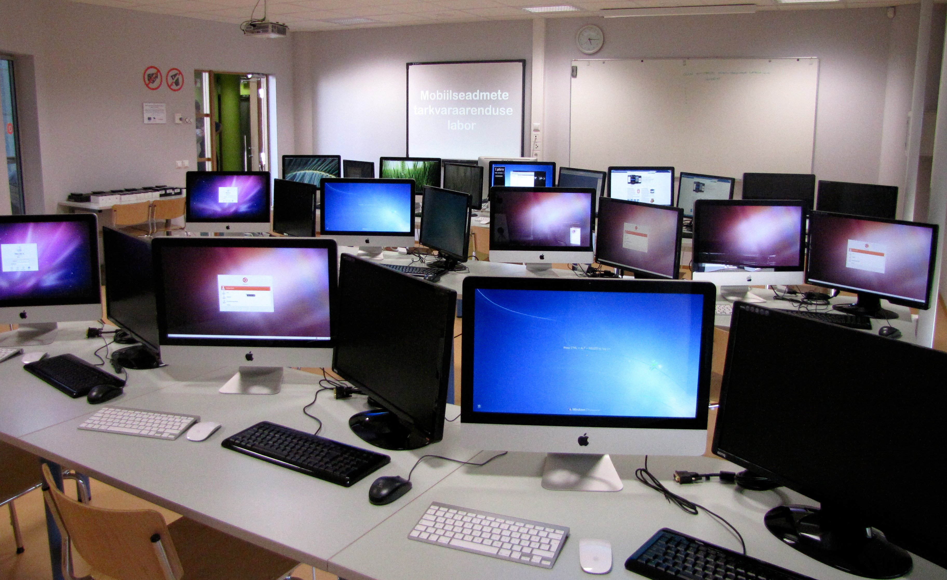
Overview:
Today’s youth are living in an age defined by technology.
With the pervasive reach of technology, our youth have access to platforms that can amplify their voices and values to a global audience.

Slide 4


EVOLUTION OF TECH AND ITS IMPACTS

Slide 5

EVOLUTION OF TECH AND ITS IMPACTS:
The digital revolution has transformed how we communicate, access information, and interact with society.
The internet - initially developed as a means for researchers and government agencies to share information, became publicly accessible in the early 1990s.

Slide 6
THE RISE OF TECHNOLOGY:
Digital platforms like social media, websites, podcasts, and apps have reshaped communication.
This has also introduced challenges, such as the spread of misinformation, privacy concerns, and the impact of digital distractions on mental health and social cohesion

Slide 7

THE CHRISTIAN YOUTH IN THE DIGITAL AGE:
As digital natives, young Christians are uniquely equipped to navigate this terrain, leveraging their technological skills and platforms to spread the message of Christ

Slide 8
THE CHRISTIAN YOUTH IN THE DIGITAL AGE:
Studies show that young people spend an average of seven hours per day on digital devices (Pew Research Center, 2022), making these platforms prime locations for evangelism, discipleship, and advocacy.

Slide 9
THE CHRISTIAN YOUTH IN THE DIGITAL AGE:
Shape online narratives, provide spiritual support, and build communities of faith that transcend physical limitations. This mission aligns with the Great Commission’s call to “go and make disciples of all nations” (Matthew 28:19).

Slide 10
BIBLICAL FOUNDATION FOR BEING DIGITAL CHAMPIONS

Slide 11
The Great Commission in a Digital World
"Go therefore and make disciples of all nations..." Matthew 28:19-20
The command to evangelize extends to the digital realm, where we can reach millions.

Slide 12

BEING SALT AND LIGHT ONLINE
"For you were once darkness, but now you are light in the Lord." Ephesians 5:8
Just as we are called to reflect Christ in our physical communities, we should do so digitally.

Slide 13
GODLY STEWARDSHIP OF TECHNOLOGY:
1 Corinthians 10:31 — "So whether you eat or drink, or whatever you do, do all to the glory of God."
Technology is a tool given by God that we must use responsibly to further His kingdom.

Slide 14
THE ROLE OF THE CHRISTIAN YOUTH IN THE DIGITAL SPACE

Slide 15

Promoting Christian Values:
Using social media platforms to share the gospel, scripture, and positive messages.
Engaging in conversations that promote hope, love, and integrity.

Slide 16

Creating Godly Content:
Blogs, vlogs, podcasts, and videos that reflect Christian teachings.
Testimonies, faith-based discussions, or even devotionals can be shared to inspire others.

Slide 17

Digital Evangelism and Discipleship:
Online Bible study groups, digital prayer circles, and social media outreach.
Using platforms like YouTube, Instagram, and TikTok to share faith-based content.
Apps like YouVersion or Bible Gateway can be used to engage with scripture digitally.

Slide 18

Combating Digital Darkness:
Standing against cyberbullying, inappropriate content, and negative trends online.
Promoting kindness, respect, and Christ-like behavior in digital interactions.

Slide 19
Practical Steps for Becoming a Digital Champion

Slide 20
PERSONAL PREPARATION:
Spiritual Grounding: Developing a strong prayer life and deep knowledge of the Word of God.
Skill Development: Learning digital tools (content creation, social media management, coding/programming, etc.).

Slide 21

BUILD A POSITIVE ONLINE PRESENCE:
Align your online activities with your Christian values.
Be intentional about what you post, share, and engage with on social media.

Slide 22
CONTENT CREATION & SHARING
Identifying Your Niche: Finding a focus area (e.g., apologetics, worship, Bible study).
Creating Engaging Content: Using videos, blogs, podcasts, and social media posts.
Leveraging Platforms: Understanding the strengths of various platforms (YouTube, Instagram, TikTok, etc.) for specific purposes.

Slide 23
CONTENT CREATION & SHARING
Identifying Your Niche: Finding a focus area (e.g., apologetics, worship, Bible study).
Creating Engaging Content: Using videos, blogs, podcasts, and social media posts.
Leveraging Platforms: Understanding the strengths of various platforms (YouTube, Instagram, TikTok, etc.) for specific purposes.

Slide 24


Engage in Digital Outreach:
Share your personal testimony on digital platforms.
Join or create online Christian communities to support each other in faith.

Slide 25
Discernment in Digital Consumption:
“Whatever is true, whatever is noble, whatever is right... think about such things.” Philippians 4:8
Be cautious about what you consume online. Focus on content that uplifts and grows your faith.

Slide 26
Conclusion and Call to Action

Slide 27
The digital world is an extension of the mission field.
We must shine the light of Christ in this space, using it to share the gospel, connect with others, and stand for truth.

Slide 28
Start small — whether through a social media post, creating faith-based content, or supporting online Christian ministries.
Commit to being intentional about your digital presence, ensuring it reflects your faith.

Slide 29
Thank You

